Slide 1
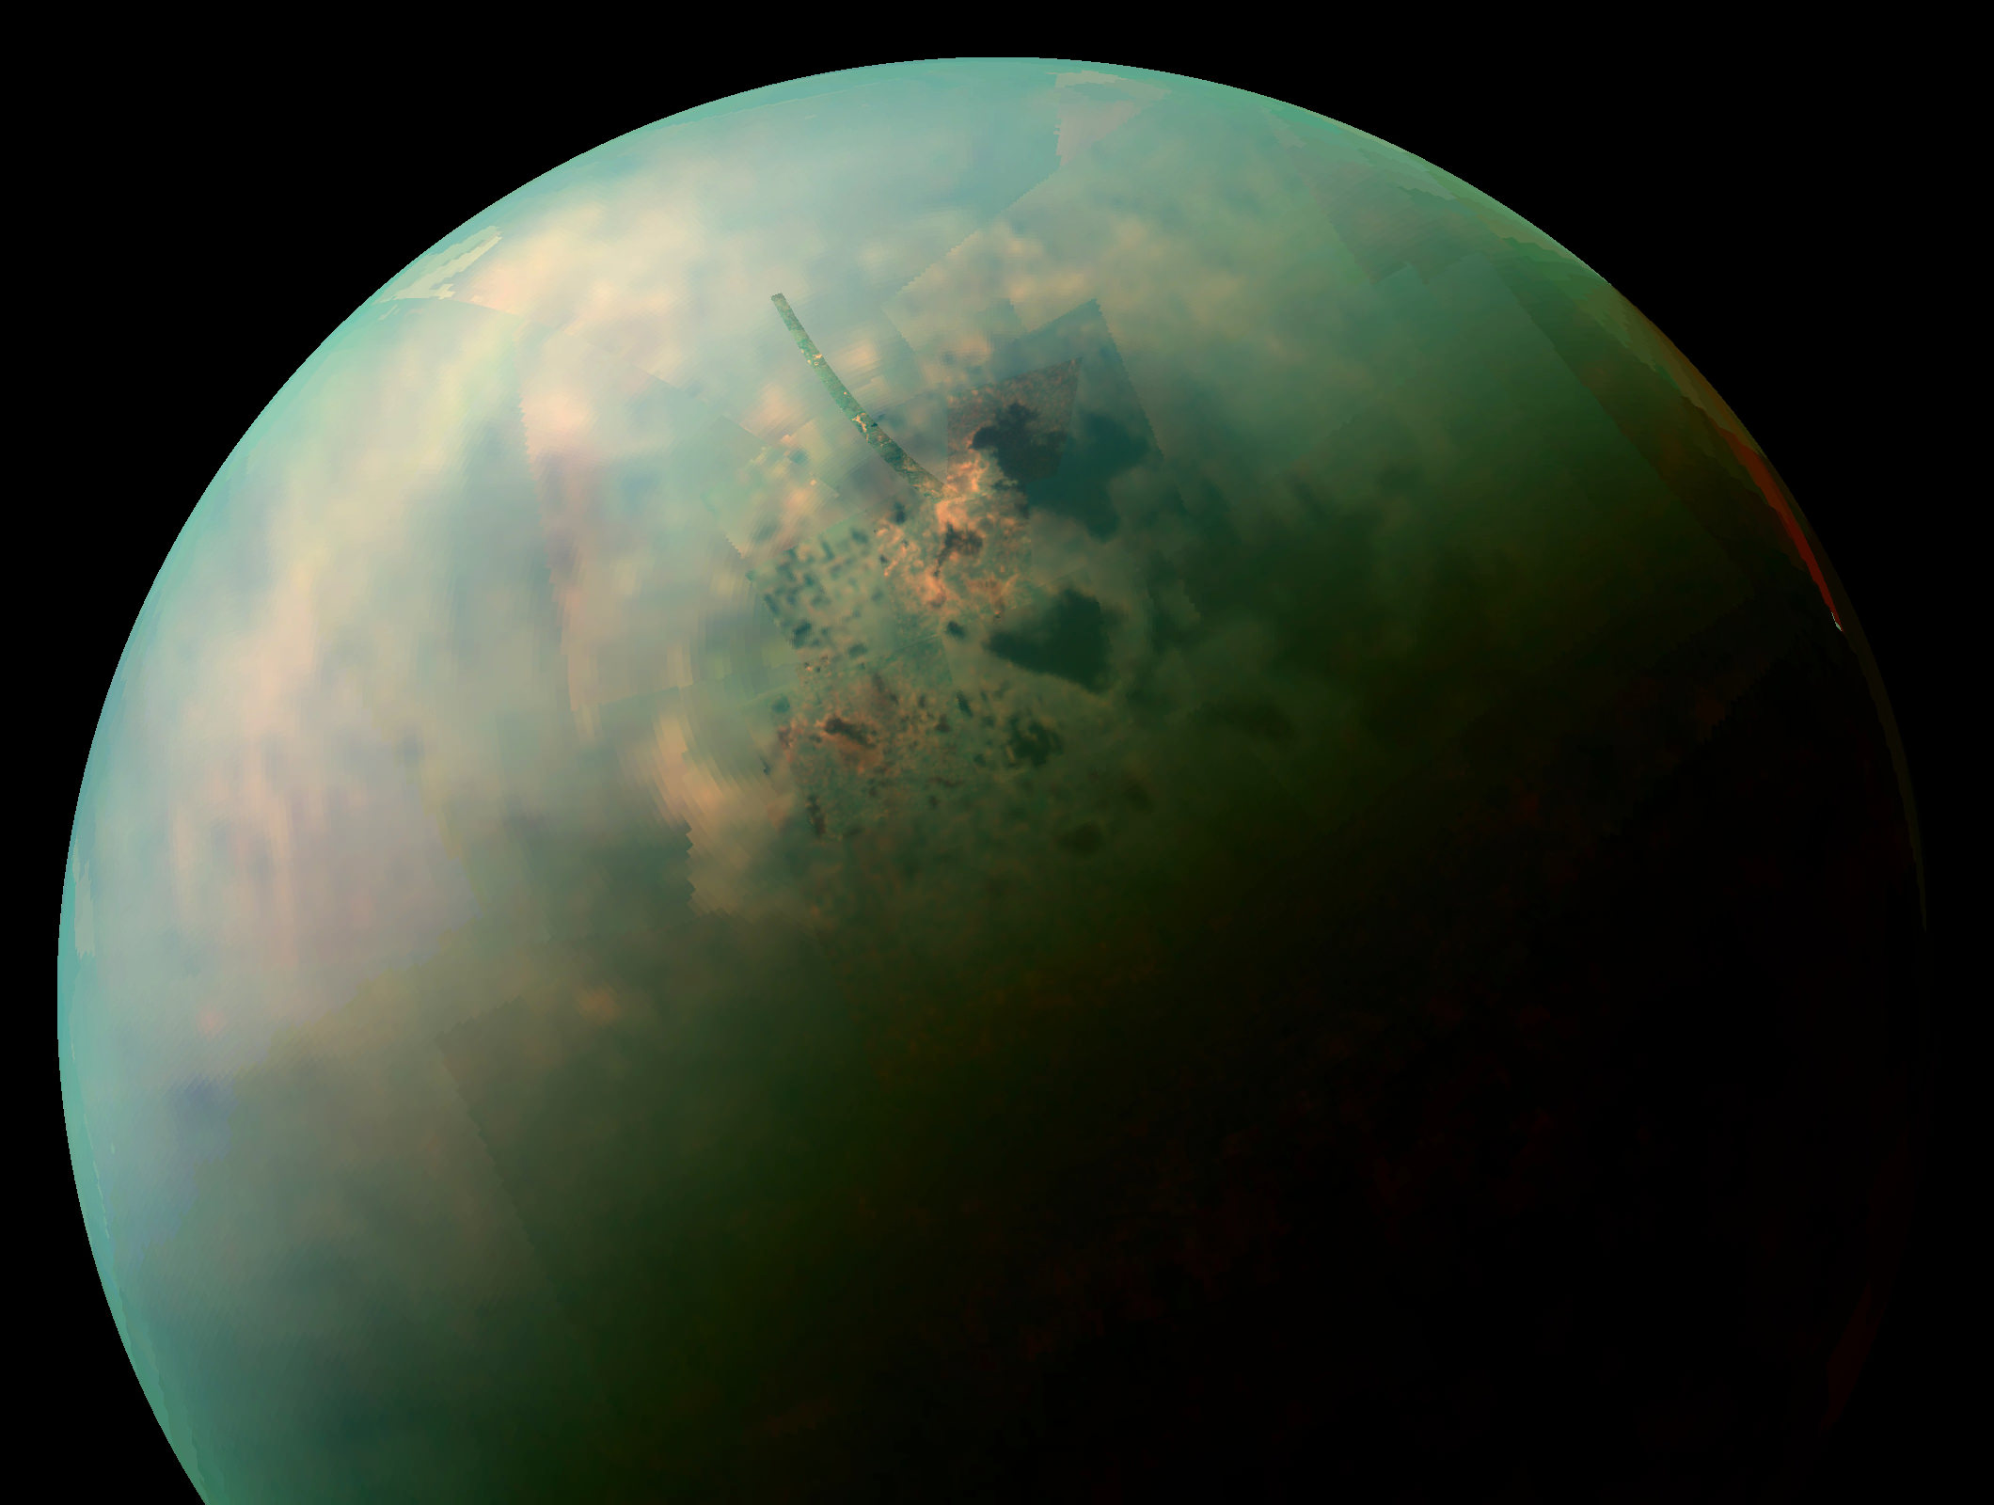
Project 2.1 – Group 11
Probe launching to Titan
Laura Jogi, Laura Vila Gonzalo, Roy Legziel, Matthew Goncalves Da Silva ,Luc Meels, Jan Socha

Slide 2
Solar system model - components
Celestial bodies: Sun, Mercury, Venus, Earth, Mars, Jupiter, Saturn, Uran, Neptun, Titan
Physics engine (gravitational force)

Slide 3
Solar system model - features
Cartesian coordinate system with Sun as its origin
3D location computations and 2D graphical interface
The model launches on <day> (NASA provides coordiantes for each body)
Physics simplification – only gravitational forces are simulated.

Slide 4
Probe trajectory
”Linear” trajectories (no gravity assist)
The launch velocity is <velocity>.
Trial and error method (changing parameters by marginal values)

Slide 5
Phase 2 - plans

